Slide 1
Spring - REST

Slide 2
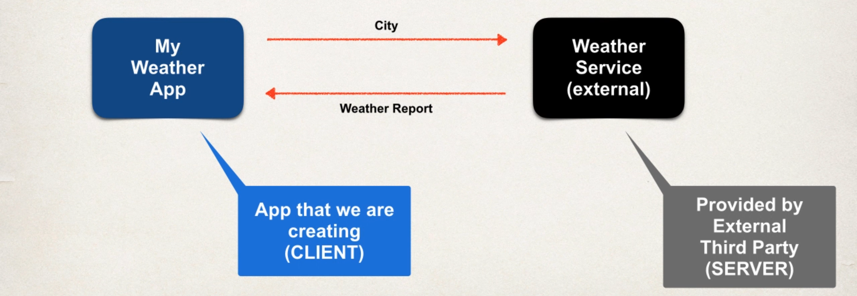
Weather Service
Application Architecture
Notes:
Provides a good alternative to EJB for most applications
Provides end-to-end framework for applications.

Slide 3
Operations
How we will connect to the Weather Service
REST – REpresentation State Transfer
Programming Language we use
Language Independent
What is Data Format
XML and JSON
Java Script Object Notation
Notes:
Provides a good alternative to EJB for most applications
Provides end-to-end framework for applications.

Slide 4
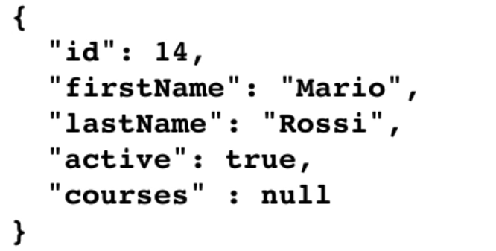
JSON Basics
JSON - Java Script Object Notation
Light Weight Data Format

Slide 5
JAVA – JSON Data Binding
Data Binding – Converting JSON Data to Java POJO ( Plain Old Java Object) or Vice Versa
Jackson Project
Conversions
JSON to Java POJO
Java POJO to JSON

Slide 6
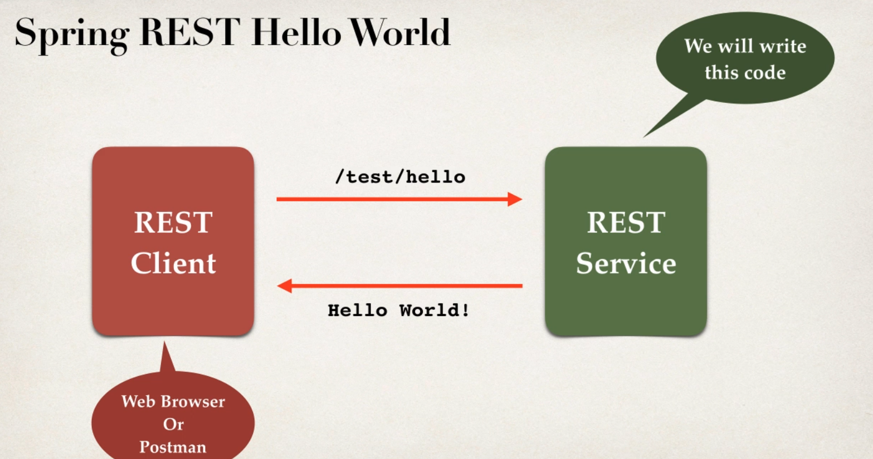
Spring Rest Controller

Slide 7
Web App Initializer
Spring MVC provides support for web
Makes Sure that our code is automatically detected
Our code is used to initialize the servlet container
AbstractAnnotationConfigDispatcherServletInitializer

Slide 8
Development Process
Add Maven Dependency for Spring MVC and Jackson Project
Add code for all Java Config : @Config
Add code for all Java Config : Servlet Initializer
Create Spring Rest Service using @RestController

Slide 9
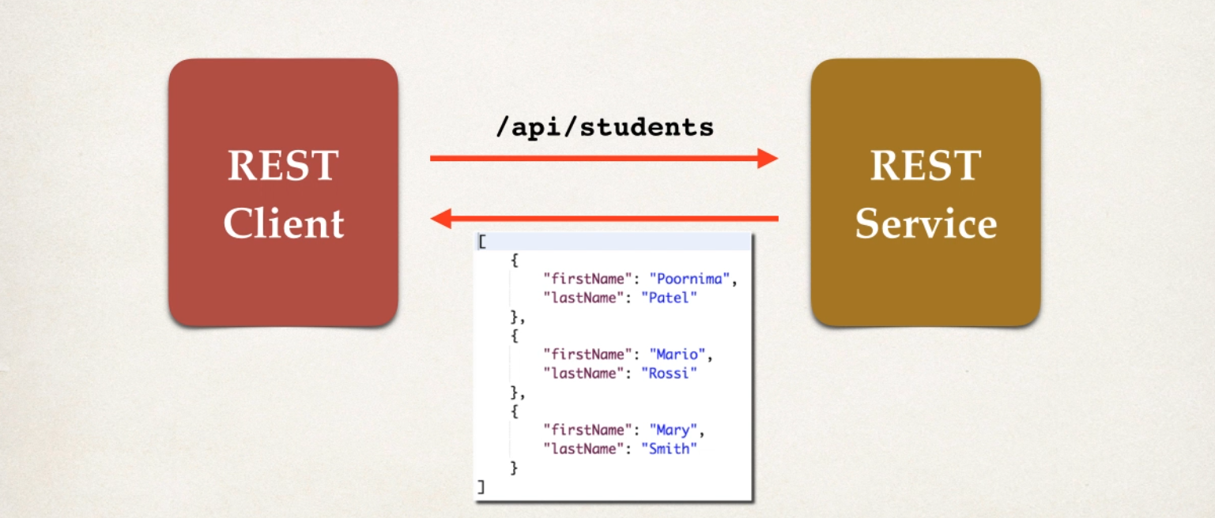
Retrieive POJO’s as JSON

Slide 10
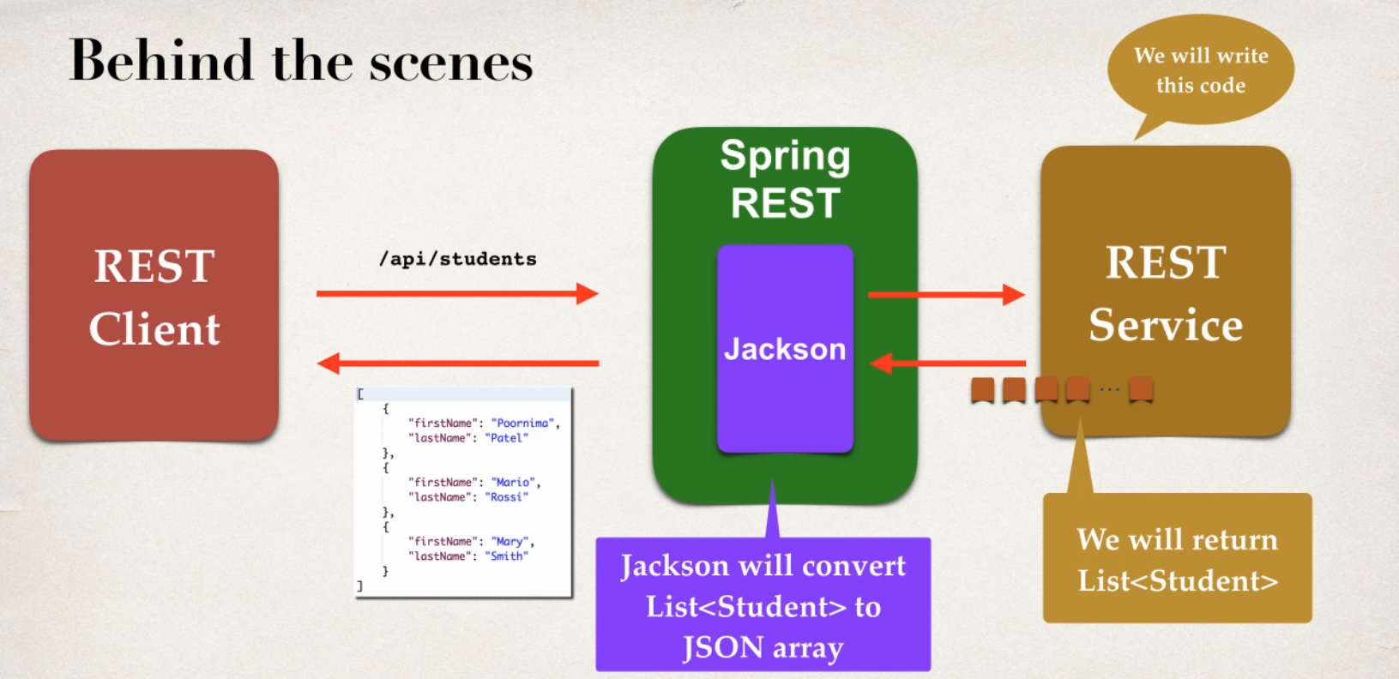

Slide 11
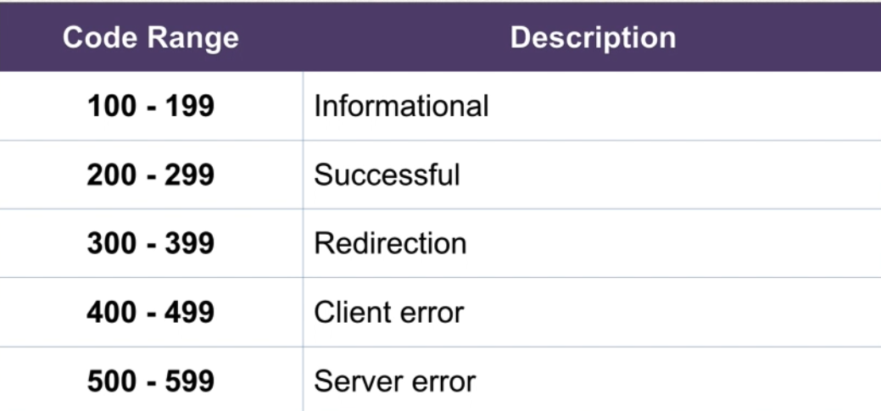
Development Process
Create Java POJO class for Student
Creating Spring REST Service Using @RestController

Slide 12
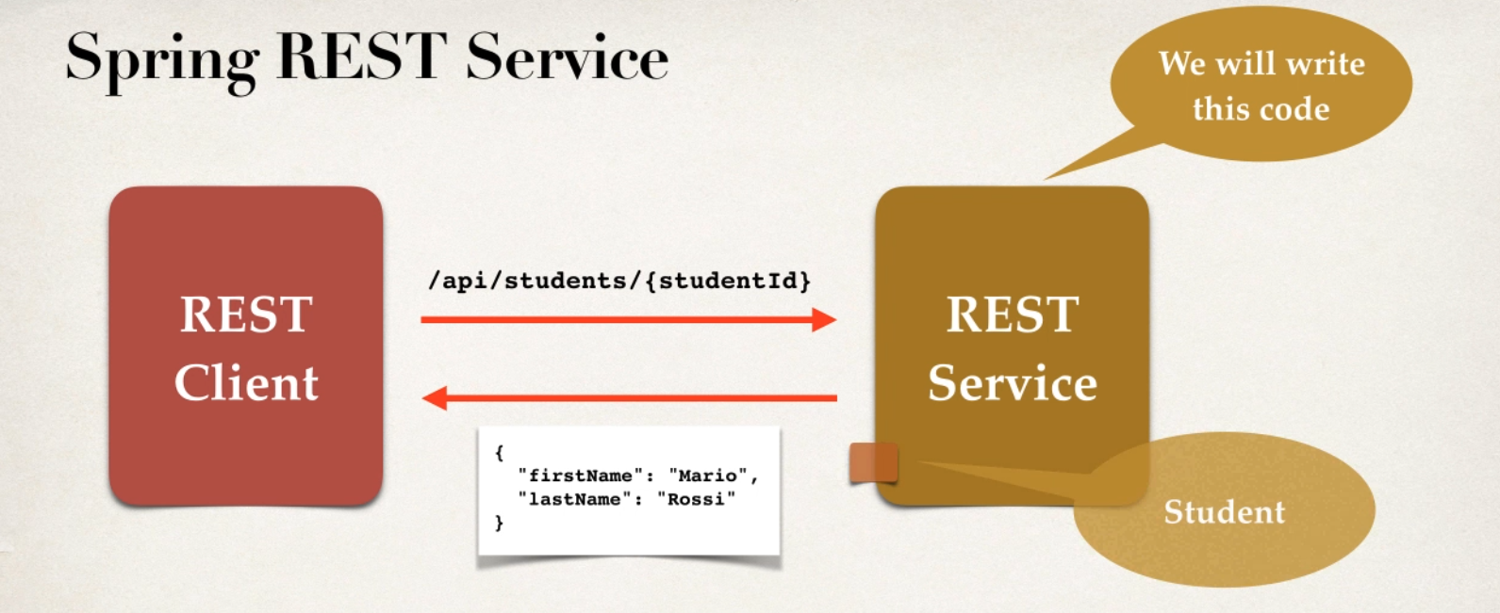
Spring REST – Path Variables : Development Process
Add request mapping to Spring REST Service
Bind Path variable to method parameter using @PathVariable

Slide 13
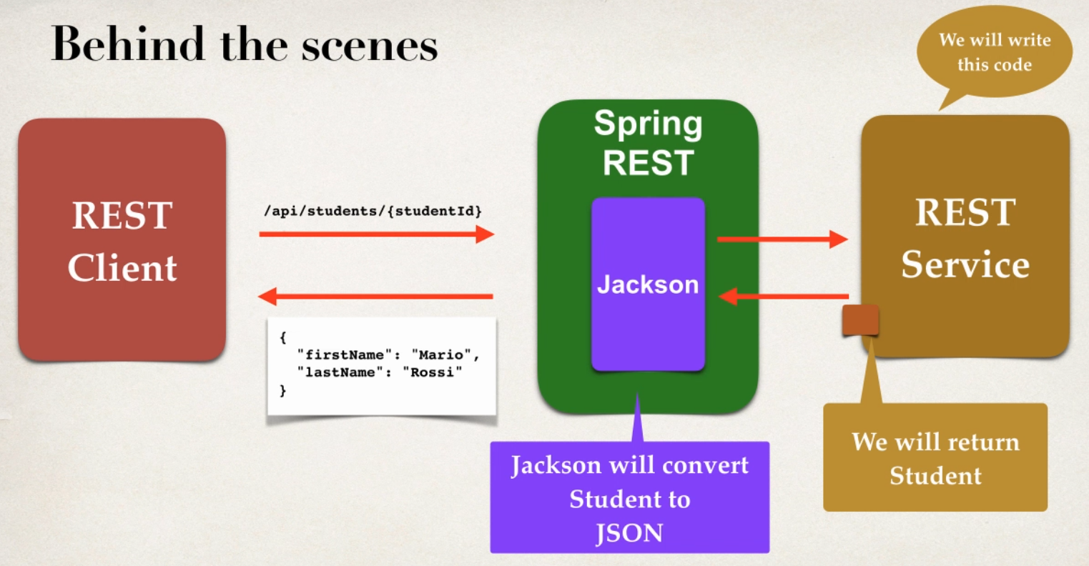

Slide 14
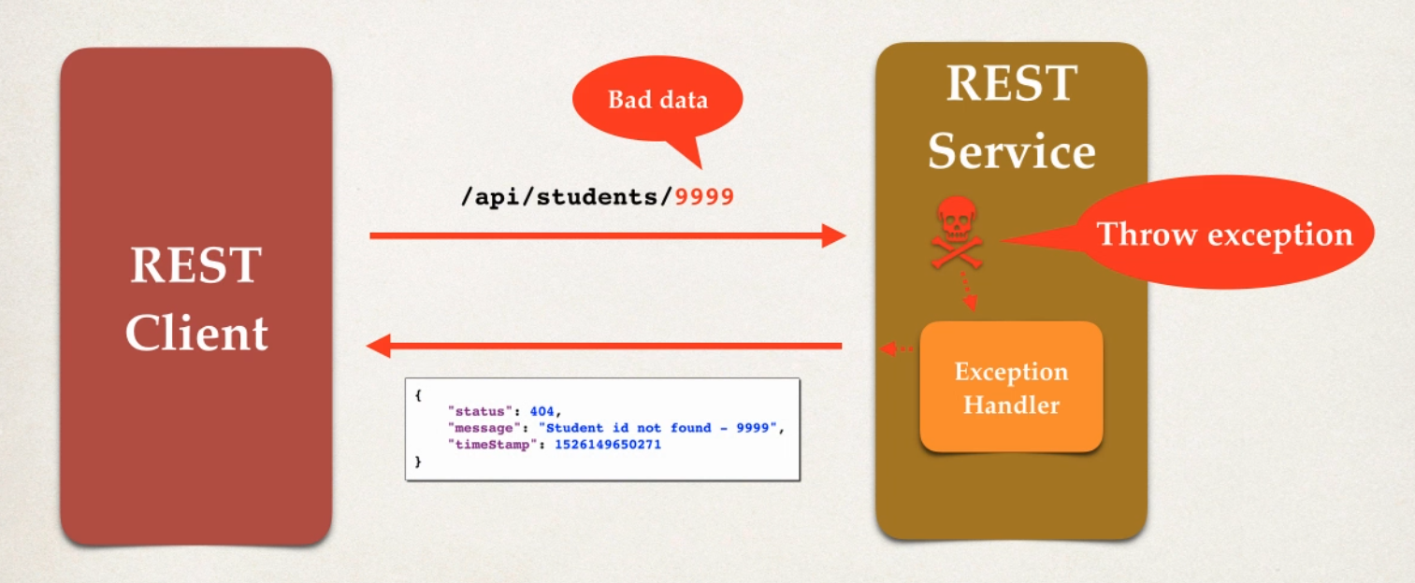
Spring REST – Exception Handling

Slide 15
Development Process
Create a custom Error Response Class
Create a custom Exception Class
Update REST service to throw exception if student not found
Add a exception handler method using @ExceptionHandler

Slide 16
Thank You

